Slide 1
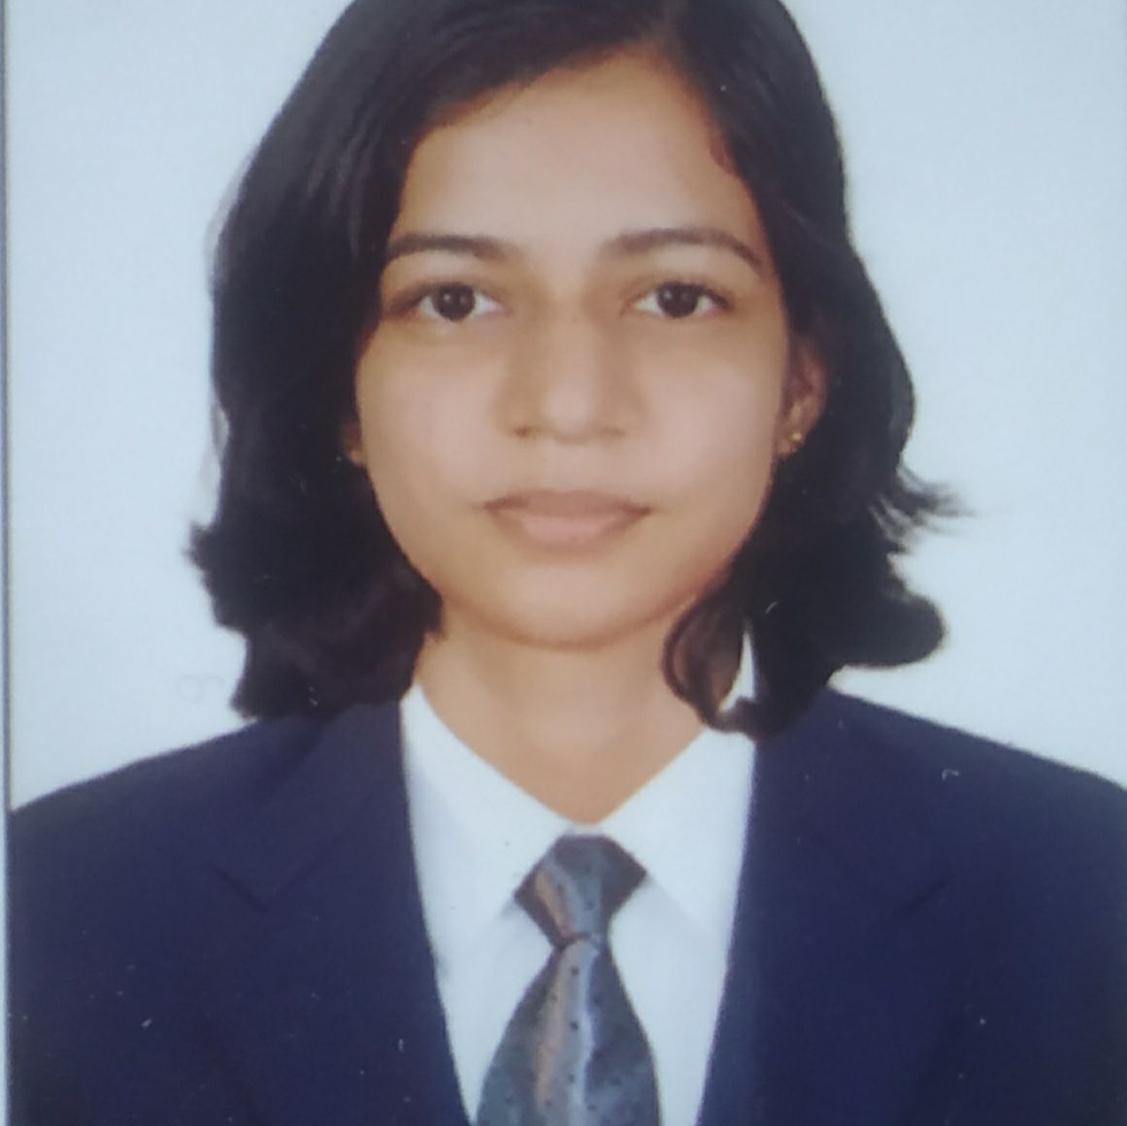

Vinaya kumari
Analyst/Software Engineer
Bachelor of Engineering : 2017-2021
Skills Java 8 /J2EE
Spring Boot
Spring MVC
JPA CRUD
Bootstrap
MERN Stack
ReactJS
MongoDB
Database
No SQL database – MongoDB
Web Technologies
HTML5
CSS3
Javascript
AddOns
Github
Maven
Postman
AddOns
Communication
Team Management
Peer learning
Mangalore
Indian
English, Kannada
Software Engineer who is Strong in design and integration with intuitive problem-solving skills. Passionate about implementing and launching new projects.
Ready to learn new technologies and implement them to further improve my knowledge.
Eager to work in a team of dedicated people and serve a key role in the enhancement and development of the project.
Has working knowledge on ReactJS(Hooks, redux)and Java Microservice Development using Spring framework on an intermediate level.
Also Implemented Nodejs in case study and upskilling day by day.
On Demand Car Wash System Application
Completed end to end case study of Car Wash System Application along with JWT authentication, Swagger and Eureka Server. Material-UI and React Bootstrap used for user interface.
Check out my work on GitHub & Video Store

